Slide 1
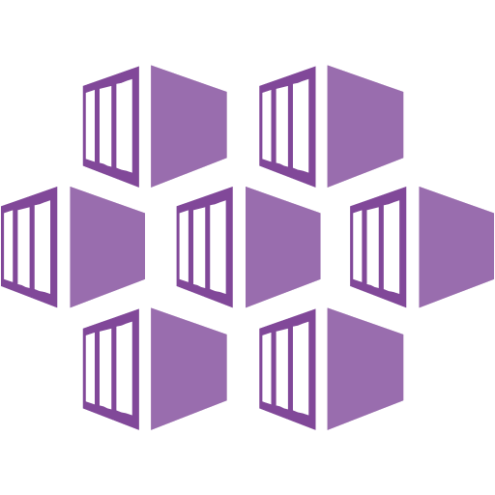
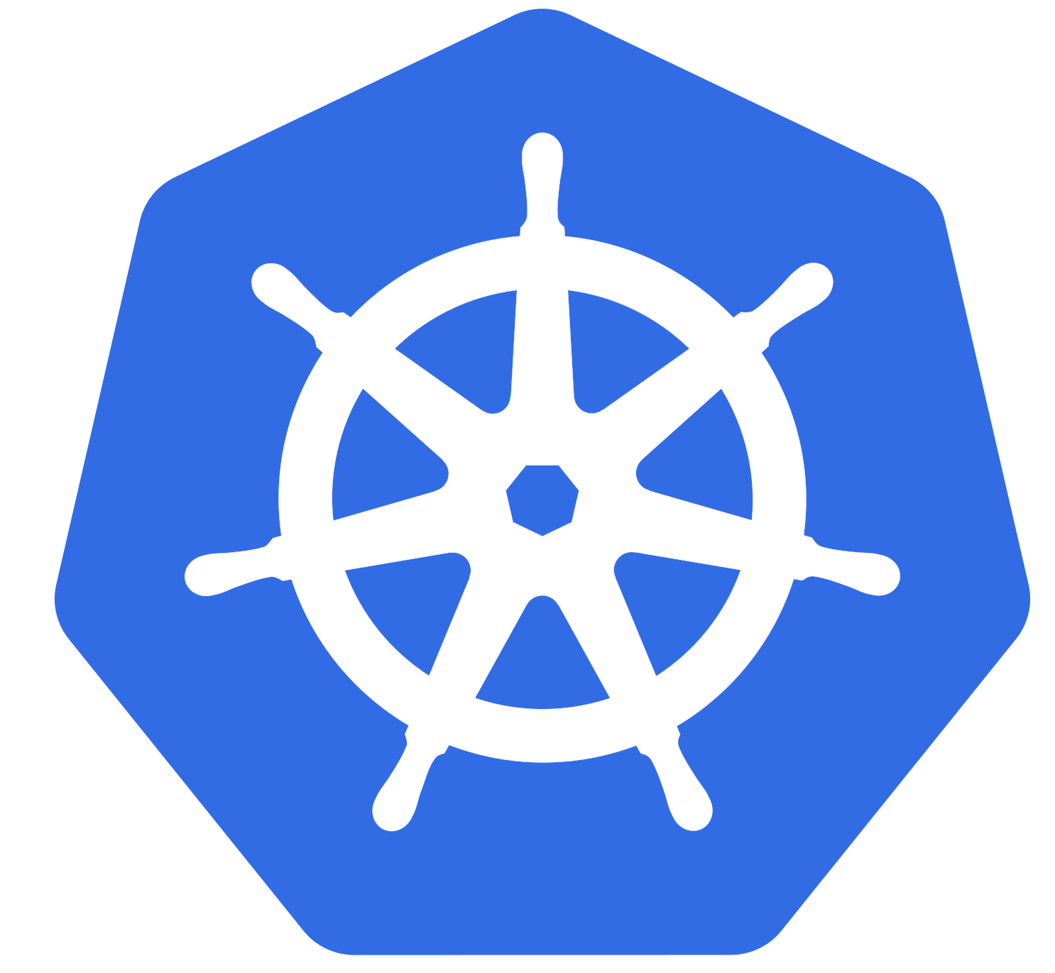
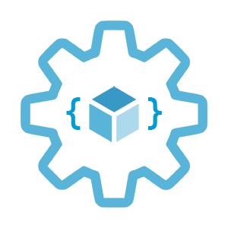

Introduction to Azure Kubernetes Service (AKS)
Infrastructure as Code User Group Oslo
09.02.2021
Evgeny Borzenin

Slide 2
Infrastructure as Code User Group 2021 roadmap
AKS workshops:
AKS and Kubernetes 101
Advanced AKS con
Use Pulumi to provision and configuring AKS clusterfiguration
Service mesh with linkerd
AKS application deployment strategy
AKS security
+ “regular” events (work in progress)
If you have any good AKS / Kubernetes / IaC story – welcome to share!

Slide 3
Practical information
Mix of slides and labs with focus on labs
I don’t have moderator
Let’s help each other, the one who finished earlier can help others
Keep the same names as in labs -> easier to troubleshot
Share your screen if you stack with something
Labs are available after the event

Slide 4
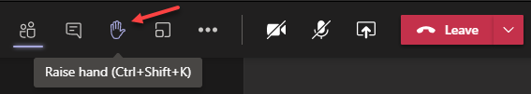
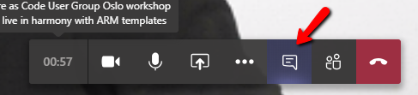

Microsoft Teams 101
Mute your mic (but don’t forget to unmute when you speak)
Feel free to use video
«Rise your hand» if you need some attention
Conversation/chat
If you want to have private discussion, find evgeny@enso.no and start chat with me
Share screen

Slide 5
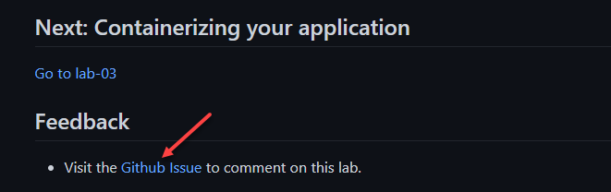
Practical information
Each lab is time-boxed (ish…)
When you completed a lab, please post to the Conversation channel
lab-01 (lab-02, lab-03 etc…)
Labs will be available after the event
Feel free to contribute to the labs content by fixing gramma, typos, wrong commands etc..
Feel free to comment on each lab

Slide 6
Workshop agenda
Slides - Kubernetes and AKS introduction (10 min)
Lab-01 - AKS setup (15 min)
Lab-02 - setting up you shell for better AKS/kubectl experience (15 min)
Slides - Introduce our "guinea pig" app (10 min)
Lab-03 - Containerizing your application (15 min)
Pause
Slides - Pods, Namespaces (10 min)
Lab-04 - Creating, managing and testing pods (15 min)
Slides - Readiness and Liveness probes (15 min)
Lab-05 - Readiness and Liveness probes (15 min)
Slides - Deployments (5 min)
Lab-06 - Deployments (15 min)
Pause
Slides - Services, Labels, Selectors (10 min)
Lab-07 - Creating and Managing Services (15 min)
Slides - Configmaps and secrets (5 min)
Lab-08 - Configmaps and secrets (15 min)
Lab-09 - AKS Kubernetes resources at the Azure portal (15 min)
Lab-10 - Cleaning up (5 min)

Slide 7
Kubernetes and AKS introduction

Slide 8
What is Kubernetes (k8s)?
Kubernetes is a Container Orchestration System and cluster technology
Manage applications, not machines
Open source, open API container orchestrator
Inspired by Google’s experiences and internal systems
Greek for pilot or Helmsman – the person who steers a ship
Kubernetes -> k(ubernete)s -> len(ubernete) = 8 -> k8s
Notes:
Kubernetes is an open source project container automation framework.
Kubernetes provides an open, pluggable API that can work with containers across multiple cloud providers.
Kubernetes is based on learnings from how Google itself has been running applications and containers, internally.
3 Google employee in 2014 and in production v1 in 2015
These learnings have given rise to new primitives, new ways of looking at orchestrating the cloud in order to abstract away the underlying machines. So that you can Manage applications, not machines

Slide 9
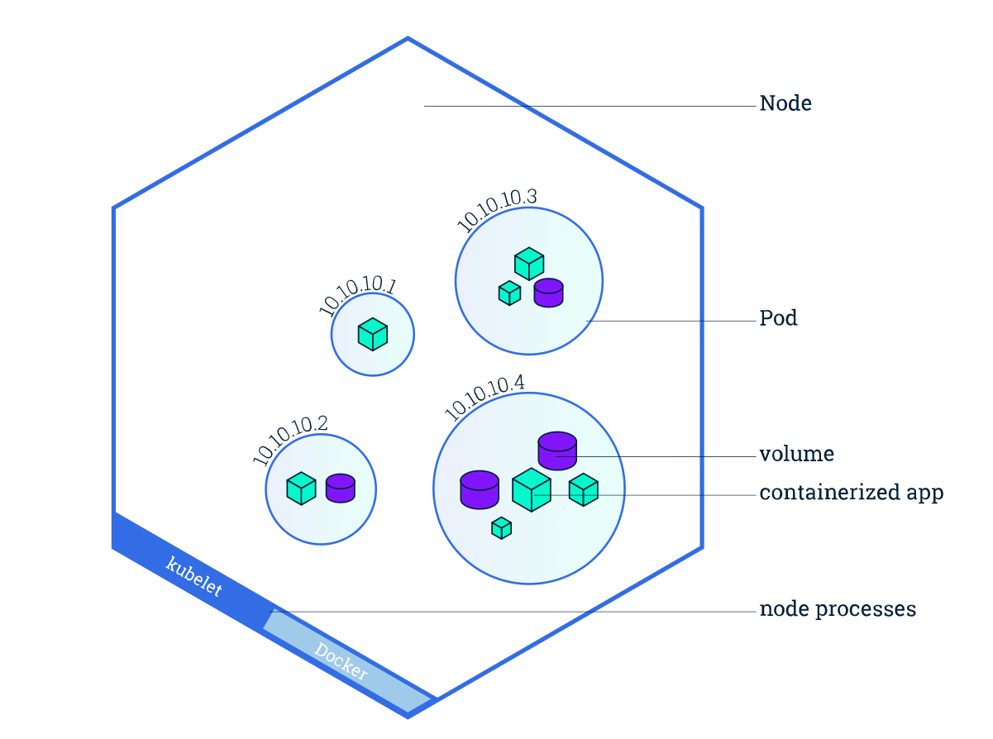
Kubernetes concepts
Nodes
Pods
Desired state (Imperative vs. Declarative)
Deployments
Services
Image from https://kubernetes.io/docs/tutorials/kubernetes-basics/explore/explore-intro/

Slide 10
K8s 101: Nodes
Nodes are machines (VM) in your cluster
Nodes can come and go
Eventually, the nodes will host your applications
Node1
Node2
Node3
Notes:
Each computer in the cluster is called a node.
Eventually, the nodes will host your applications.

Slide 11
K8s 101: Pods
Pods are the smallest deployment unit
A single Pod can hold multiple containers
Node1
Node2
Node3
pod
pod
pod
pod
app-a
app-b
app-b
app-a
app-d
Notes:
Pods are the smallest unit you will eventually deploy to the cluster.
A single Pod can hold multiple containers.

Slide 12
K8s 101: Desired State
Tell Kubernetes what you want, not what to do
Kubernetes always tries to steer the cluster to its desired state
You: “Hey, k8s, I want 3 replicas of app-a”
K8s: “Here are 3 replicas of app-a”
K8s: “Upps, one just died, I will try to find a node where I can spin up a new replica”
K8s: “Here are 3 replicas of app-a”

Slide 13
K8s 101: Deployment
Deployments are requirements you give to Kubernetes regarding your applications (Pods)
k8s: I need 2 replicas of app-a and 3 replicas of app-b
Node1
Node2
Node3
pod
pod
pod
pod
pod
app-a
app-b
app-b
app-a
app-b
Notes:
Deployments are requirements you give to Kubernetes regarding your applications (Pods)

Slide 14
K8s 101: Services
Services are an abstract way to expose an application running on a set of Pods
A Service has a name and maps to a dynamic set of Pods defined by a label selector
service-a
service-b
Node1
Node2
Node3
pod
pod
pod
pod
pod
app-a
app-b
app-b
app-a
app-b
Notes:
Services are an abstract way to expose an application running on a set of Pods as a network service.

Slide 15

Azure Kubernetes Service (AKS)
+
=
Notes:
Azure Kubernetes Service (AKS) is a managed Kubernetes offering that simplifies container-based application deployment and management.
Azure Kubernetes Service (AKS) provides a managed Kubernetes service that reduces the complexity for deployment and core management tasks, including coordinating upgrades.

Slide 16
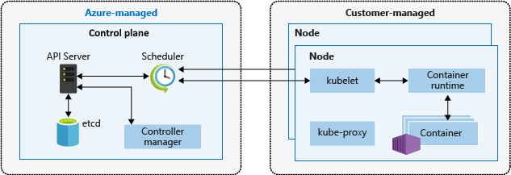
AKS cluster architecture
Image from https://docs.microsoft.com/en-us/azure/aks/concepts-clusters-workloads
Notes:
The AKS control plane is managed by the Azure platform, and you only pay for the AKS nodes that run your applications. AKS is built on top of the open-source Azure Kubernetes Service Engine (aks-engine).
When you create an AKS cluster, a control plane is automatically created and configured. This control plane is provided as a managed Azure resource abstracted from the user. There's no cost for the control plane, only the nodes that are part of the AKS cluster.
kube-apiserver - The API server is how the underlying Kubernetes APIs are exposed. This component provides the interaction for management tools, such as kubectl or the Kubernetes dashboard.
etcd - To maintain the state of your Kubernetes cluster and configuration, the highly available etcd is a key value store within Kubernetes.
kube-scheduler - When you create or scale applications, the Scheduler determines what nodes can run the workload and starts them.
kube-controller-manager - The Controller Manager oversees a number of smaller Controllers that perform actions such as replicating pods and handling node operations.

Slide 17
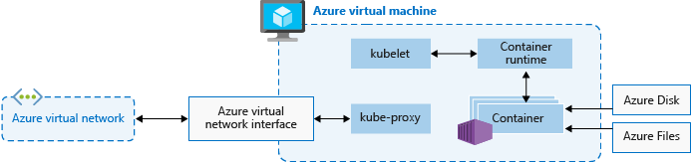
AKS nodes
Image from https://docs.microsoft.com/en-us/azure/aks/concepts-clusters-workloads
Notes:
To run your applications and supporting services, you need a Kubernetes node. An AKS cluster has one or more nodes, which is an Azure virtual machine (VM) that runs the Kubernetes node components and container runtime.
The kubelet is the Kubernetes agent that processes the orchestration requests from the control plane and scheduling of running the requested containers.
Virtual networking is handled by the kube-proxy on each node. The proxy routes network traffic and manages IP addressing for services and pods.
The container runtime is the component that allows containerized applications to run and interact with additional resources such as the virtual network and storage.

Slide 18
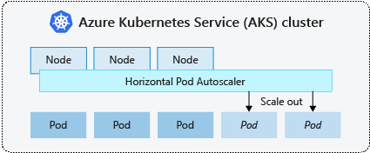
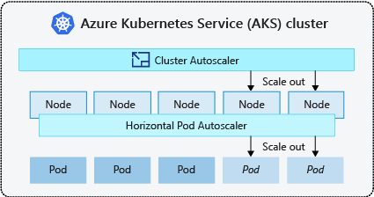
AKS scaling options
Manually scale pods or nodes
Horizontal pod autoscaler
Cluster autoscaler
https://docs.microsoft.com/en-us/azure/aks/concepts-scale
Notes:
You can manually scale replicas (pods) and nodes to test how your application responds to a change in available resources and state. Manually scaling resources also lets you define a set amount of resources to use to maintain a fixed cost, such as the number of nodes. To manually scale, you define the replica or node count.
Kubernetes uses the horizontal pod autoscaler (HPA) to monitor the resource demand and automatically scale the number of replicas. When you configure the horizontal pod autoscaler, you define the minimum and maximum number of replicas that can run. You also define the metric to monitor and base any scaling decisions on.
To respond to changing pod demands, Kubernetes has a cluster autoscaler, that adjusts the number of nodes based on the requested compute resources in the node pool. Cluster autoscaler is typically used alongside the horizontal pod autoscaler.

Slide 19






AKS scaling options
AKS
docker push
docker pull
ACR
Virtual Network
Resource Group
Log Analytics
Monitor

Slide 20
Lab-01, 02, 03

Slide 21
Pause

Slide 22
k8s 101: Pods

Slide 23
Pods
A Pod is an abstraction that represents:
a group of one or more application containers
Shared storage, as Volumes
Networking, as a unique cluster IP address
Information about image version and specific ports to use
10.240.0.3
pod
app-a
app-b
Config
map
Secrets

Slide 24
Lab-04

Slide 25
k8s 101: Readiness and Liveness probes
Notes:
With containers in production, it’s not enough to know that a container is running. We need to know that the application inside of the container is functioning. To that end, Kubernetes allows for user defined health and readiness checks. Passing a readiness check tells Kubernetes that a pod is available to receive traffic. If it fails the readiness probes, Kubernetes will stop sending it traffic. Liveness checks on the other hand are used to tell Kubernetes when to restart a pod. If a pod fails three liveness checks that signifies that the app is malfunctioning and kubernetes will restart it. Let’s see a liveness check in action.

Slide 26
Liveness probe
On every node is a daemon called a Kubelet
One of the Kubelet’s jobs is to ensure that pods are healthy
Kubelet sends out a liveness probe to a pod
app-a, are you alive?
No
Node
kubelet
pod
app-a

Slide 27
Liveness probe
If the Kubelet gets back multiple bad responses
app-a, restart!
Node
kubelet
pod
app-a

Slide 28
Liveness probe
This cycle then starts all over again
app-a, are you alive?
Yes!
Node
kubelet
pod
app-a

Slide 29
Readiness probe
app-a is already alive
kubelet sends readiness probe
If app-a is not ready, wait and send new request
service-a
app-a, are you ready?
Node
kubelet
pod
pod
pod
app-a
app-a
app-a
Not yet

Slide 30
Readiness probe
This cycle then starts all over again
Send traffic to app-a
service-a
app-a, are you ready?
Node
kubelet
pod
pod
pod
app-a
app-a
app-a
Yes!

Slide 31
Lab-05

Slide 32
k8s 101: Deployments
Notes:
Until now, we haven’t really talked about machines. In my opinion, that’s one of the great things about Kubernetes -- it lets you focus on what really matters: the application. But, applications (or Pods in Kuberntes lingo) have to run on machines. You saw before that when we launched a Pod, Kubernetes assigned it to a machine (or Node in Kubernetes lingo) for us. Still, it would be nice if we didn’t have to launch Pods directly. To that end, Kubernetes gives us another structure called “Deployments”. Deployments understand “desired state”. Ie, we specify how many replicas we want of our application and a deployment will actively monitor our pods and make sure we always have enough running. On screen we have three Nodes and one Pod. Since we’ve only specified that we want one of our Pods running, all is good in the world.

Slide 33
Deployments
Drive current state towards desired state
app: app-a
replicas: 3
app: app-a
replicas: 1
Node1
Node2
Node3
Node3
pod
pod
pod
pod
app-a
app-a
app-a
app-a

Slide 34
Rolling Update
service-a
Node1
Node1
Node1
pod
pod
pod
pod
app-a: v1
app-a: v1
app-a: v1
app-a: v2
Notes:
So it happened - the code has changed. Now what do we do? We update it. When it comes to deploying code, we want to avoid downtime at all costs. We want to be able to cautiously rollout changes and, if necessary, be able to quickly roll back to a working state. Some design patterns in the space have evolved: namely Blue/Green and Canary deployments. Kubernetes can handle both but let’s take a second to see the built-in RollingUpdate strategy of Deployments. RollingUpdates allow us to rollout a new version of a Pod, while keeping the old version around. As we are scaling up the new version of our Pods, *both* will still be getting traffic. This allows us to cautiously test that the new version works as expected. And, if it doesn’t, we can stop the update and rollback to the version we had before. The next couple of slides show this in action.

Slide 35
Rolling Update
service-a
Node1
Node1
Node1
pod
pod
pod
pod
app-a: v1
app-a: v1
app-a: v1
app-a: v2

Slide 36
Rolling Update
service-a
Node1
Node1
Node1
pod
pod
pod
pod
app-a: v1
app-a: v2
app-a: v1
app-a: v2

Slide 37
Rolling Update
service-a
Node1
Node1
Node1
pod
pod
pod
pod
app-a: v1
app-a: v2
app-a: v1
app-a: v2

Slide 38
Rolling Update
service-a
Node1
Node1
Node1
pod
pod
pod
pod
app-a: v2
app-a: v1
app-a: v2
app-a: v2

Slide 39
Rolling Update
service-a
Node1
Node1
Node1
pod
pod
pod
pod
app-a: v2
app-a: v1
app-a: v2
app-a: v2
Notes:
This cycle continues until we’re left with just the desired amount of Pods (all of which will be of our new version).

Slide 40
Rolling Update
service-a
Node1
Node1
Node1
pod
pod
pod
app-a: v2
app-a: v2
app-a: v2

Slide 41
Lab-06

Slide 42
Pause

Slide 43
k8s 101: Services, Labels, Selectors

Slide 44
Services
Persistent Endpoint for Pods
Use Labels and Selectors to select Pods
service-a
pod
pod
pod
app-a
app-a
app-a
labels:
app: app-a
labels:
app: app-a
labels:
app: app-a
Notes:
We don’t care which Pod serves up a particular request, but we must get one of them to do it.
Kubernetes supports naming and load balancing using the service abstraction:
a service has a name and maps to a dynamic set of pods defined by a label selector.
Any container in the cluster can connect to the service using the service name. Under the covers, Kubernetes automatically load-balances connections to the service among the pods that match the label selector, and keeps track of where the pods are running as they get rescheduled over time due to failures.

Slide 45
Labels and selector
selector:
app: app-a
pod
pod
pod
app-a
app-a
app-a
labels:
app: app-a
version: v1
labels:
app: app-a
version: v1
labels:
app: app-a
version: v2
Notes:
We don’t care which Pod serves up a particular request, but we must get one of them to do it.
Kubernetes supports naming and load balancing using the service abstraction:
a service has a name and maps to a dynamic set of pods defined by a label selector.
Any container in the cluster can connect to the service using the service name. Under the covers, Kubernetes automatically load-balances connections to the service among the pods that match the label selector, and keeps track of where the pods are running as they get rescheduled over time due to failures.

Slide 46
Labels and selector
selector:
app: app-a
version: v1
pod
pod
pod
app-a
app-a
app-a
labels:
app: app-a
version: v1
labels:
app: app-a
version: v1
labels:
app: app-a
version: v2
Notes:
We don’t care which Pod serves up a particular request, but we must get one of them to do it.
Kubernetes supports naming and load balancing using the service abstraction:
a service has a name and maps to a dynamic set of pods defined by a label selector.
Any container in the cluster can connect to the service using the service name. Under the covers, Kubernetes automatically load-balances connections to the service among the pods that match the label selector, and keeps track of where the pods are running as they get rescheduled over time due to failures.

Slide 47
Lab-07

Slide 48
k8s 101: Configmaps and secrets
Notes:
We don’t want to hard code sensitive credentials directly into our code or configuration.
Secrets allow you to mount sensitive data as either a file in a volume, or directly into environment variables. The next few slides animates how it works in k8s. The same applicable for ConfigMaps

Slide 49
Secrets and ConfigMaps
kubectl create secret / kubectl cerate cm
Node
10.240.0.3
pod
kubelet
app-a
/etc/secrets
secret/
ConfigMap
Notes:
Step 1: We use the `kubectl create secret` command to create our secret and let the Kubernetes API server now about it.
Step 2: Create a pod that references that secret. This reference lives in the Pod’s manifest (json or yaml) file under the Volumes entry.
Step 3: Kubernetes starts creating the pod
Step 3 (continued): The secret gets volume loaded into the Pod.
Step 3 (continued): The secret volume gets mounted into the Pod contianer’s file system.
Step 3 (continued): The pod is assigned an IP address.
Step 3 (continued): Finally, the Pod’s contianer is started. As you can see from this process -- the secrets (and config data if you’re using a ConfigMap) are available for the Pod’s containers *before* they are started. Kubernetes handles all of this for you.

Slide 50
Lab-08, 09

